Slide 1
Connected Device Studio Skill Transfer Workshop
Kevin Kao | Walker Lin | Andy Li
Microsoft IoT Innovation Center

Slide 2
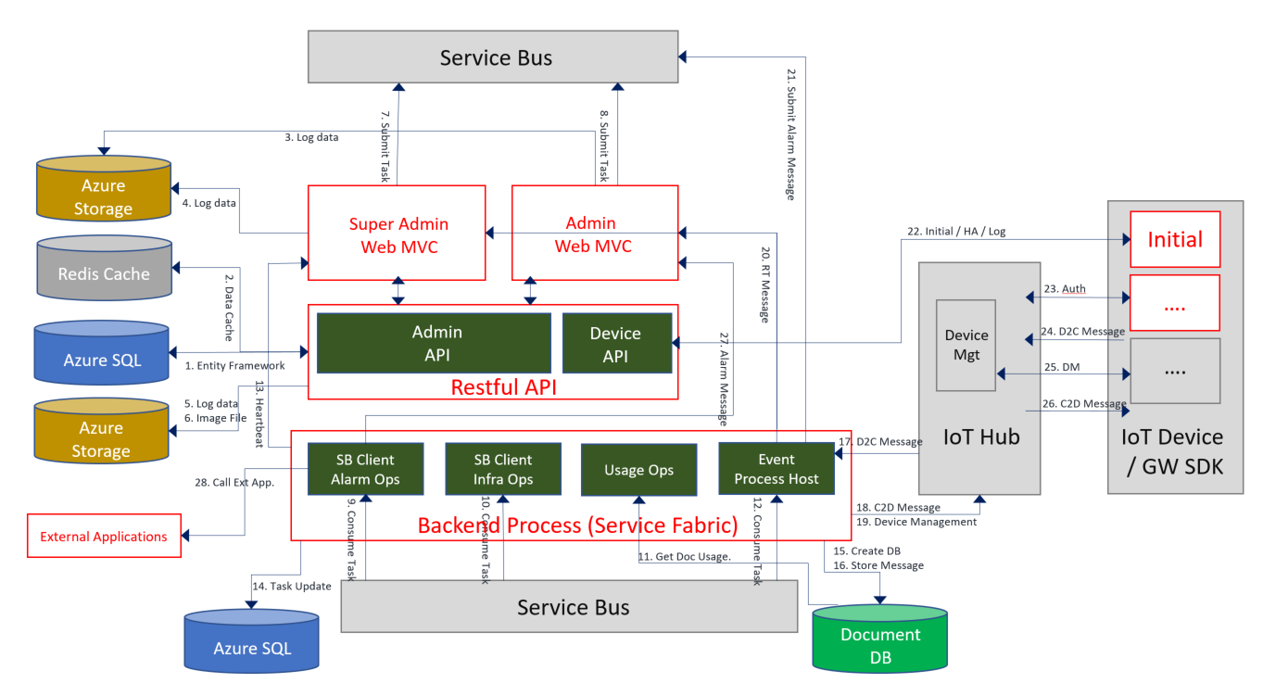
Architecture

Slide 3
Required Azure Services
Azure Service | Suggested Spec | List Price | Min Spec | List Price
Azure SQL | S1 20 DTU | 30 | S1 20 DTU | 30
Azure Redis Cache | C0 250MB | 16.37 | C0 250MB | 16.37
Web App Service / API Service01 | App Plan 1 S1 App Plan 2 S1 | 74.40 | App Plan 1 B1 | 55.80
Web App Service / API Service02
Web App Service / Admin |  | 74.40
Web App Service / SuperAdmin
Traffic Manager | 1 M DNS query/month | 1.80 | None | None
Azure Blob Storage | 20G | 0.53 | 20G | 0.53
Azure Service Bus | 1 M msg/month | 10 | 1 M msg/month | 10
Document DB | S1 (10GB) | 25.30 | S1 (10GB) | 25.30
IoT Hub | S1 (400K msg/day) | 50 | Free (8K msg/day) | 0
Azure Service Fabric | 3 Nodes A1 | 200.88 | 1s Nodes A1 | 66.96
483.68 USD
204.96 USD

Slide 4
Optional Services
Service
X.509 Certificate for Service Fabric | Public / Self-Signed
X.509 Certificate for Admin Web (HTTPS) | Public / Self-Signed
X.509 Certificate for SuperAdmin (HTTPS) | Public / Self-Signed
DNS / Domain Name

Slide 5
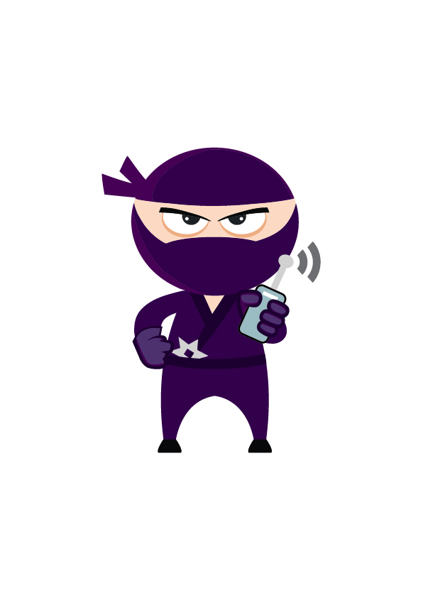
Deploy Azure Services by PowerShell

Slide 6
Deploy Azure Services
Install up to date PowerShell (01.IntallAzureRMPowerShell)
Modify 02.Deploy.ps1
Run 02.Deploy.ps1
Azure SQL
Azure Redis Cache
Web App Service / API Service01 (HK)
Web App Service / API Service02 (SG)
Traffic Manager
Web App Service / Admin (HK)
Web App Service / SuperAdmin (SG)
Azure Storage
Azure Service Bus
Document DB
KeyVault
Service Fabric

Slide 7
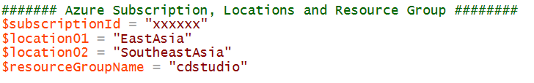
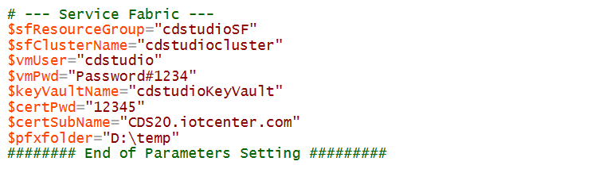
2. Modify 02.Deploy.ps1
Replace with your Azure Subscription Id
Replace All ‘cdstudio’ with your unique name.
Low case character
Only ‘a’ ~ ‘z’
Replace Certificate PW
Certificate will be saved here, make sure folder exist.

Slide 8
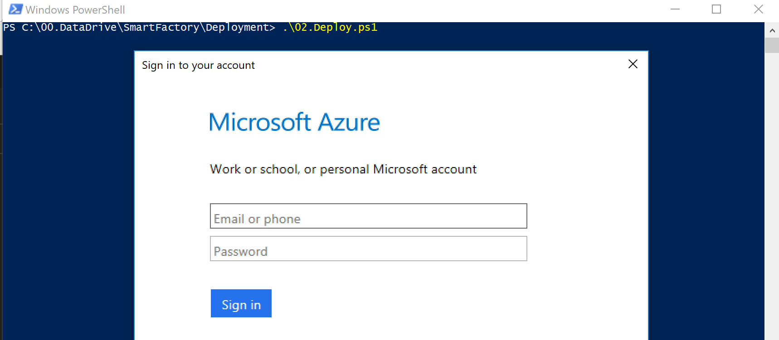
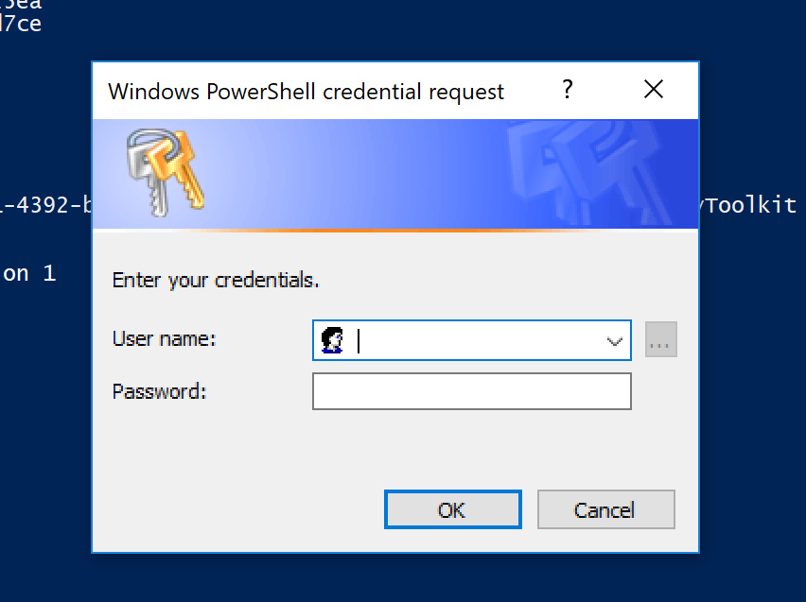
4. Run 02.Deploy.ps1
Run PowerShell as Administrator
SQL DB Admin Account
SQL DB Admin Password

Slide 9
Azure SQL Password Policy
The password does not contain the account name of the user.
The password is at least eight characters long.
The password contains characters from three of the following four categories:
A ~ Z
a ~ z
0 ~ 9
!@#$%^

Slide 10
Deploy Database Schema and Data

Slide 11
Get and Build Connected Device Studio
Install Azure Service Fabric SDK (Google: Azure Service Fabric sdk)
Load CDS solution (Visual Studio 2017)
Rebuild All Projects (make sure no any error)

Slide 12
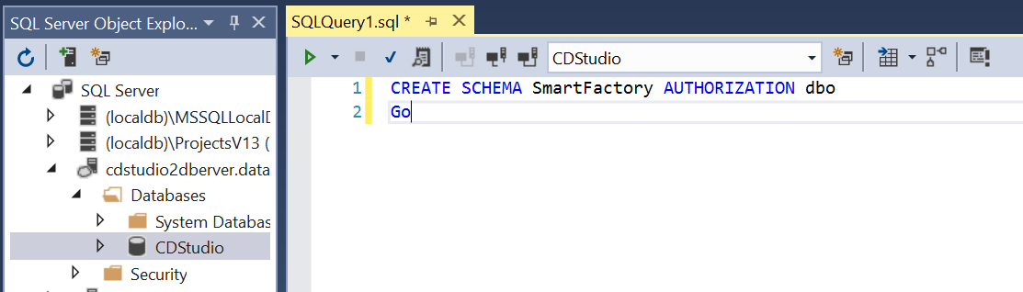
Deploy Database Schema and Data
Open SQL Server Object Explorer, Add Azure SQL
01_CreateSchema.sql
02_CreateTables.sql
03_InsertReferenceData.sql

Slide 13
Deploy API Service, Admin and Super Admin Front-end Apps

Slide 14
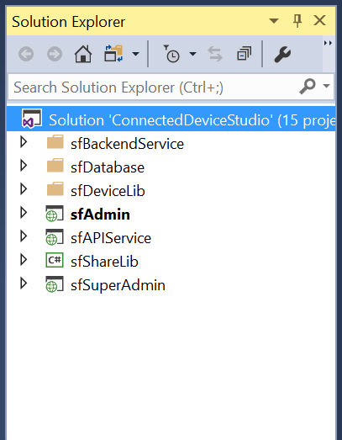
Modify and Publish Front-end Apps
sfAdmin, sfAPIService, sfSuperAdmin
Run ReplaceConString.exe
Get Publish Profiles (API Services, Admin, SuperAdmin)
Publish Front-end Apps

Slide 15
2. Run ReplaceConString.exe
Copy Build/Tools/ReplaceConString.exe to Solution Folder
Copy Build/configString.txt to Solution Folder
Go to Solution Folder, and Run ReplaceConString.exe
This program will replace correct parameters into all web.config and app.config

Slide 16
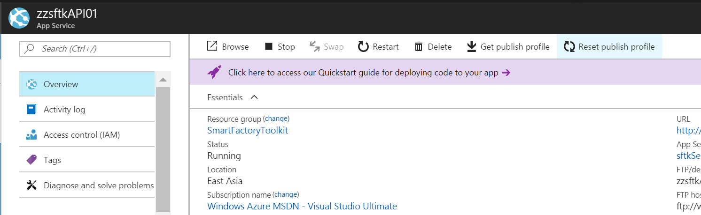
4. Get Publish Profiles X 3

Slide 17
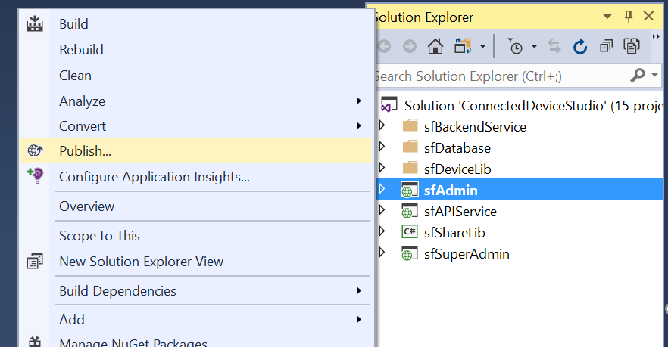
5. Publish Front-end Apps
Build Front-end Apps Project by Release Mode + Any CPU
Publish
sfAPIService X 2
sfAdmin
sfSuperAdmin

Slide 18
Login to SuperAdmin

Slide 19
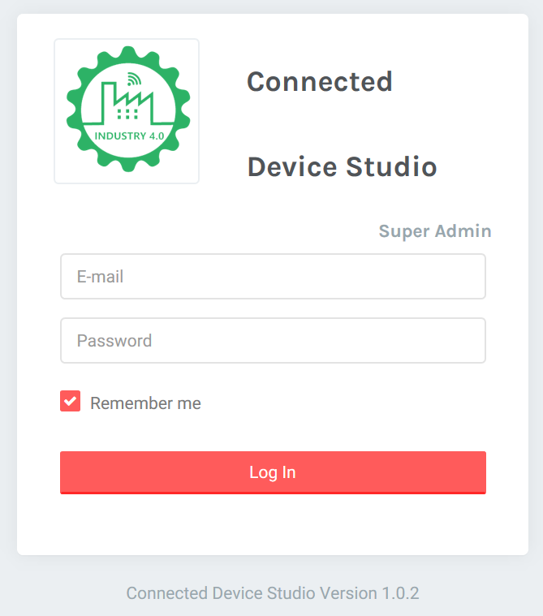
Login to SuperAdmin
Email: super@cdstudio.com
PW: super@cdstudio.com

Slide 20
Deploy Backend Tasks IoT Hub Receiver

Slide 21
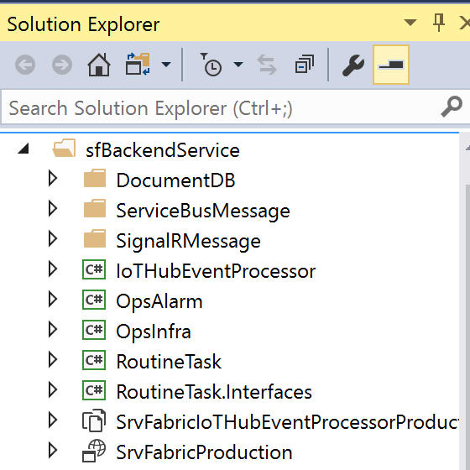
Deploy Backend Tasks
IoTHubEvenProcessor, OpsInfra, OpsAlarm, RoutineTask
Import Self-Signed X.509 into Desktop PC
Copy Self-Signed X.509 to Azure Storage
Rebuild & Publish to Service Fabric
Verify

Slide 22
Get Your Self-Sign X.509 Certificate
Certificate will be saved here, make sure folder exist.

Slide 23
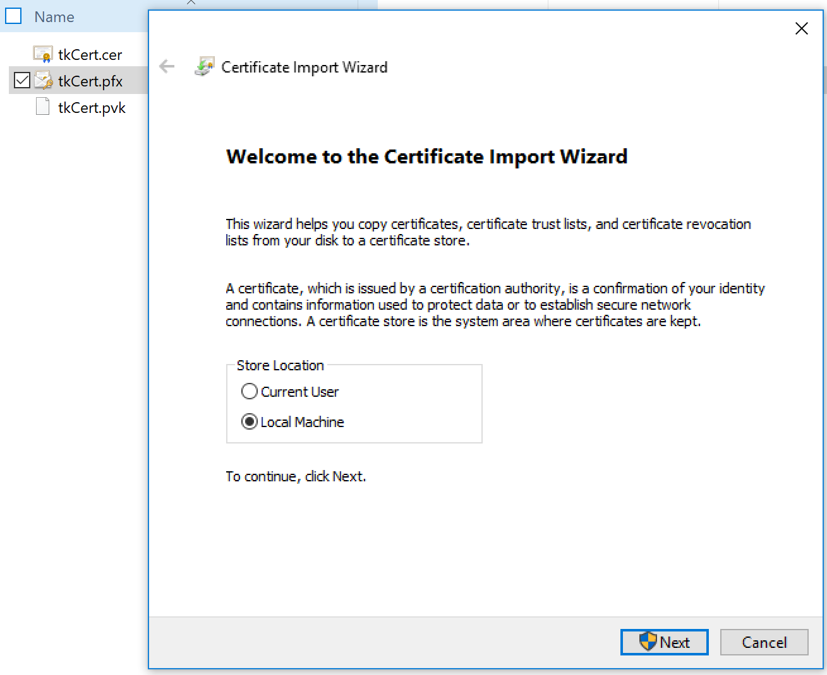
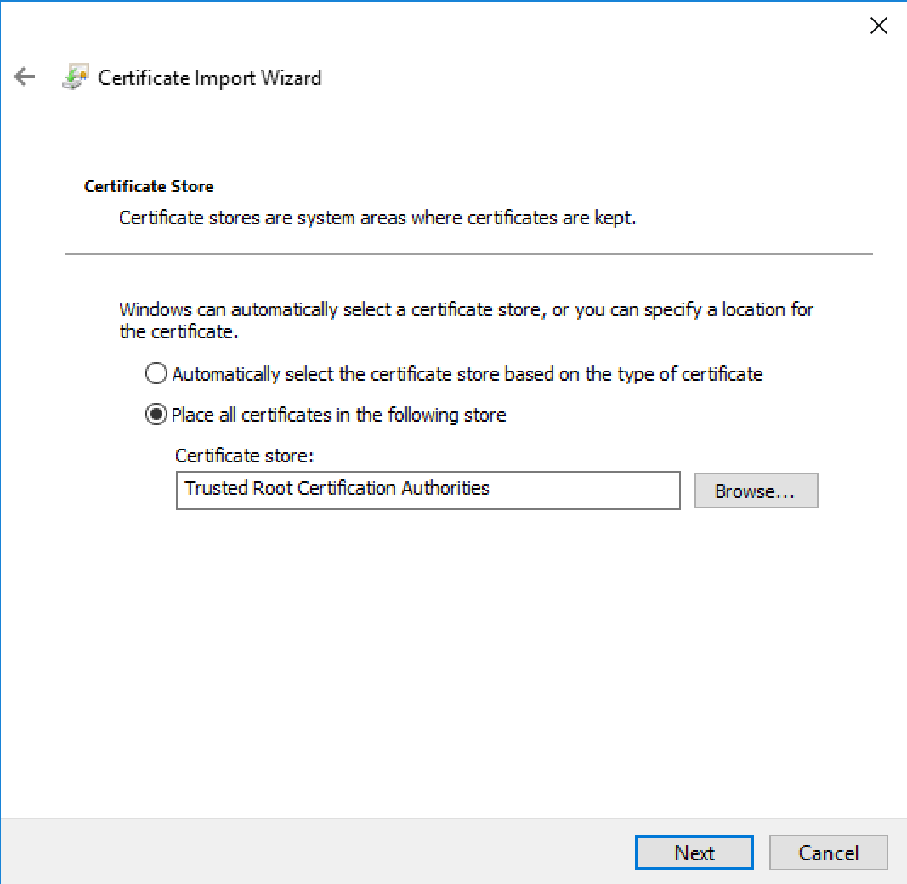
2. Import Self-Signed X.509 into [Local Machine] / Trust Root

Slide 24
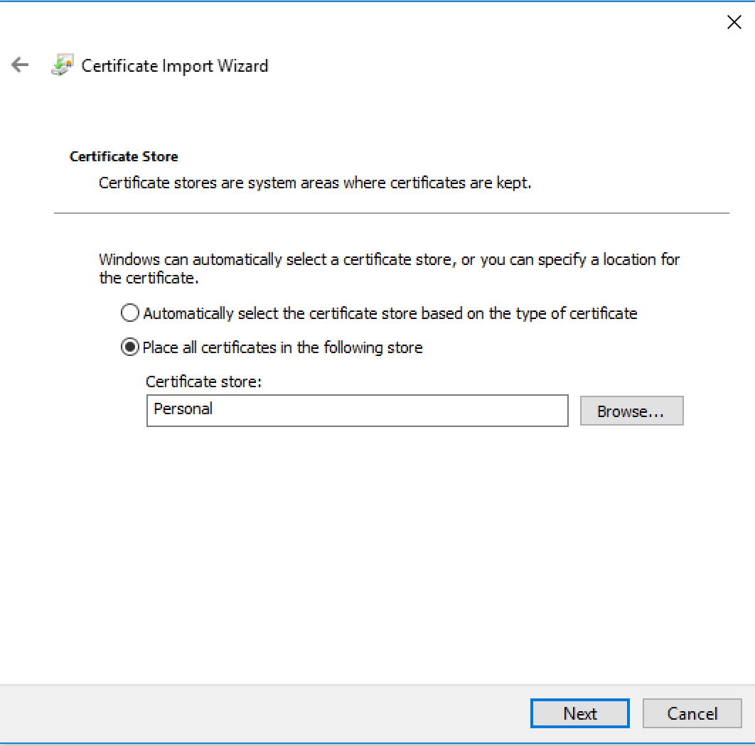
2. Import Self-Signed X.509 into [Local Machine] / Personal

Slide 25
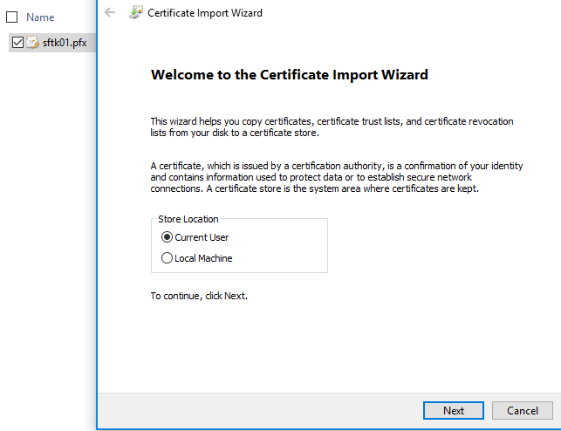
2. Import Self-Signed X.509 into [Current User] / Personal

Slide 26
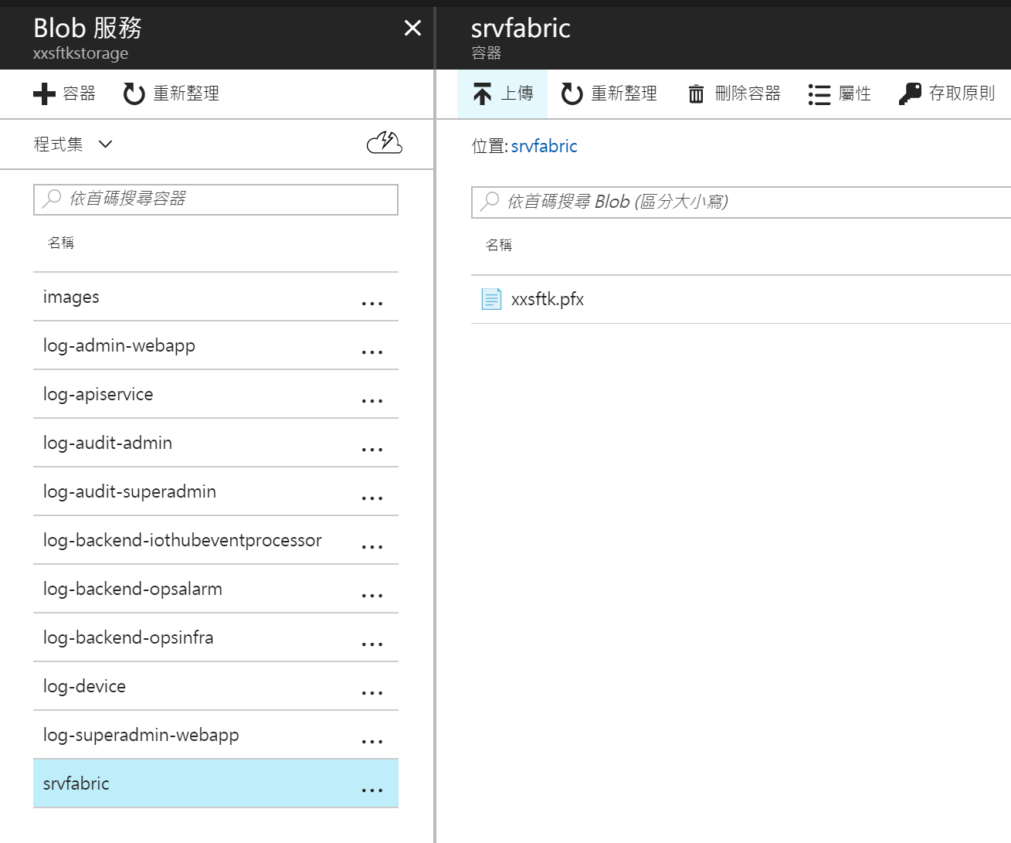
3. Copy Self-Signed X.509 to Azure Storage

Slide 27
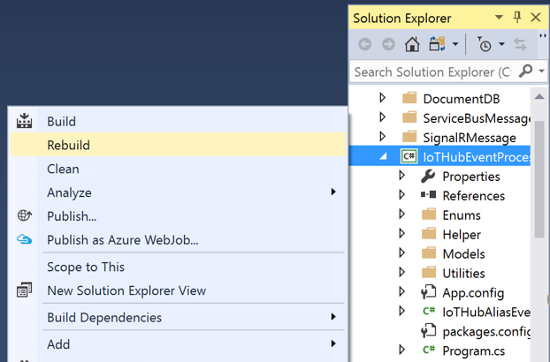
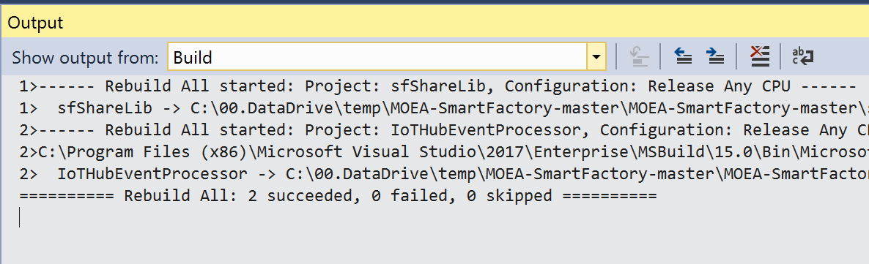
4. Rebuild and Publish to Service Fabric
Rebuild IoTHubEventProcessor Project by Release Mode + X64 CPU

Slide 28
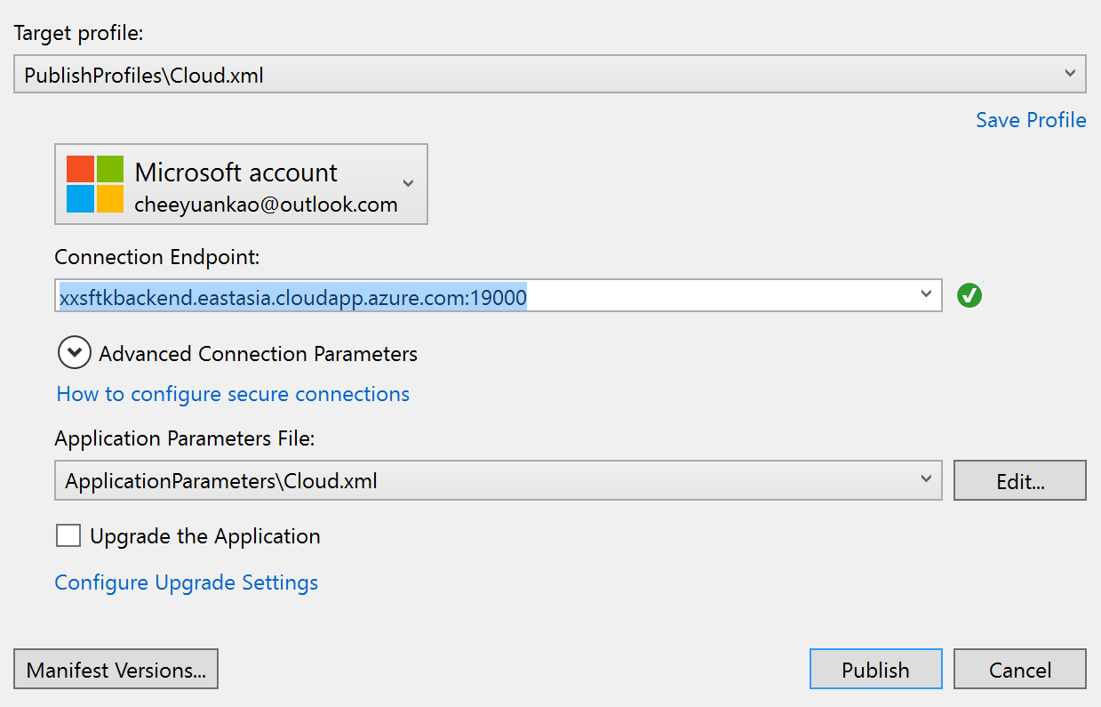
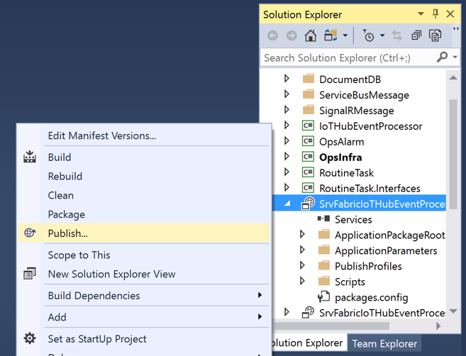
Rebuild and Publish to Service Fabric
Publish to Service Fabric : SrvFabricIoTHubEventProcessorProduction

Slide 29
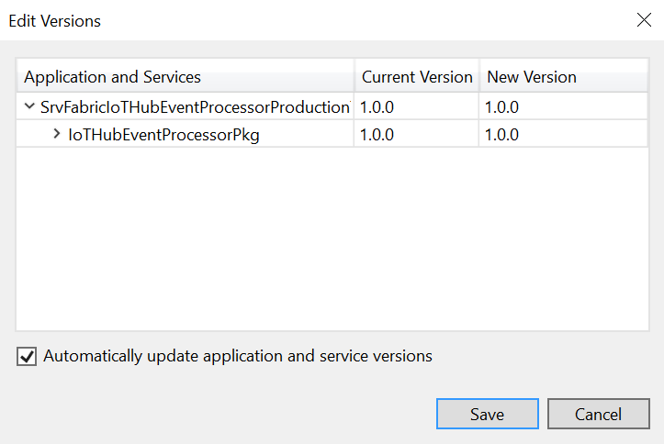
IoTHubEventProcessor Version
OpsInfra App.config

Slide 30
Deploy Backend Tasks OpsInfra, OpsAlarm, Routine Task

Slide 31
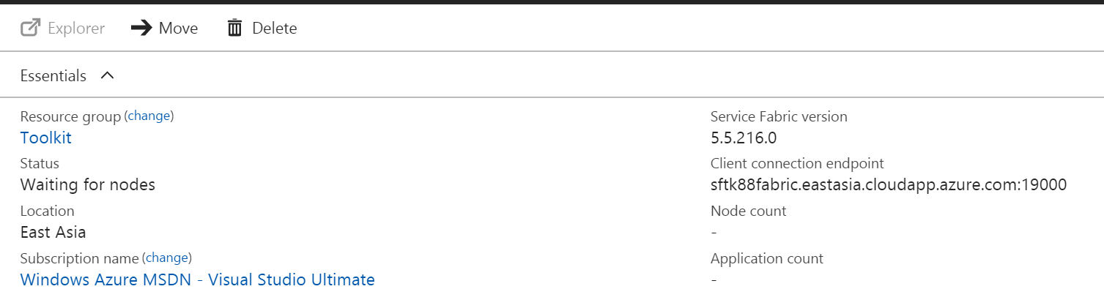
4. Verify app.config – OpsInfra Project
<appSetting>
<key="sfSrvFabricBaseURI“ value=“https://xxxxxxxx:19080/”/>
<key="sfSrvFabricCertificate" value="srvfabric/xxxxxx.pfx" />
<key="sfSrvFabricCertificatePW" value="xxxxxx" />
</appSetting>

Slide 32
IoTHubEventProcessor Version
OpsInfra App.config

Slide 33
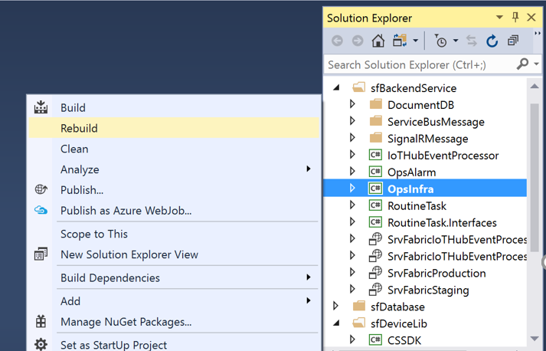
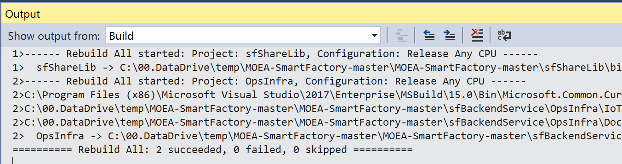
5. Rebuild and Publish to Service Fabric
Rebuild 3 Projects by Release Mode + X64 CPU
- OpsAlarm
- OpxInfra
- RoutneTask

Slide 34
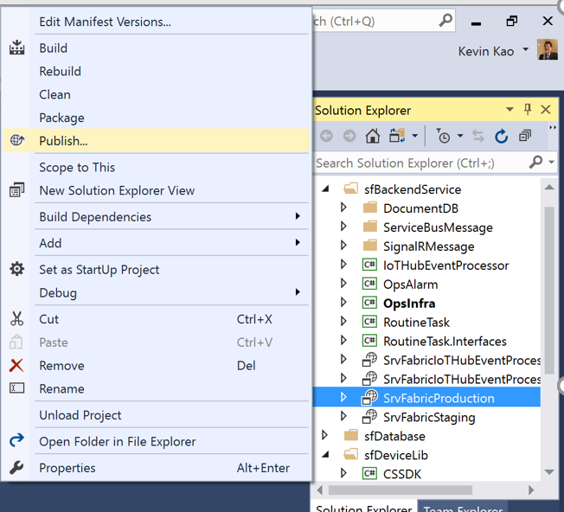
5. Rebuild and Publish to Service Fabric
Build SrvFabricProduction by Release Mode + X64 CPU
Verify Service Fabric is Ready before Publish to Service Fabric

Slide 35
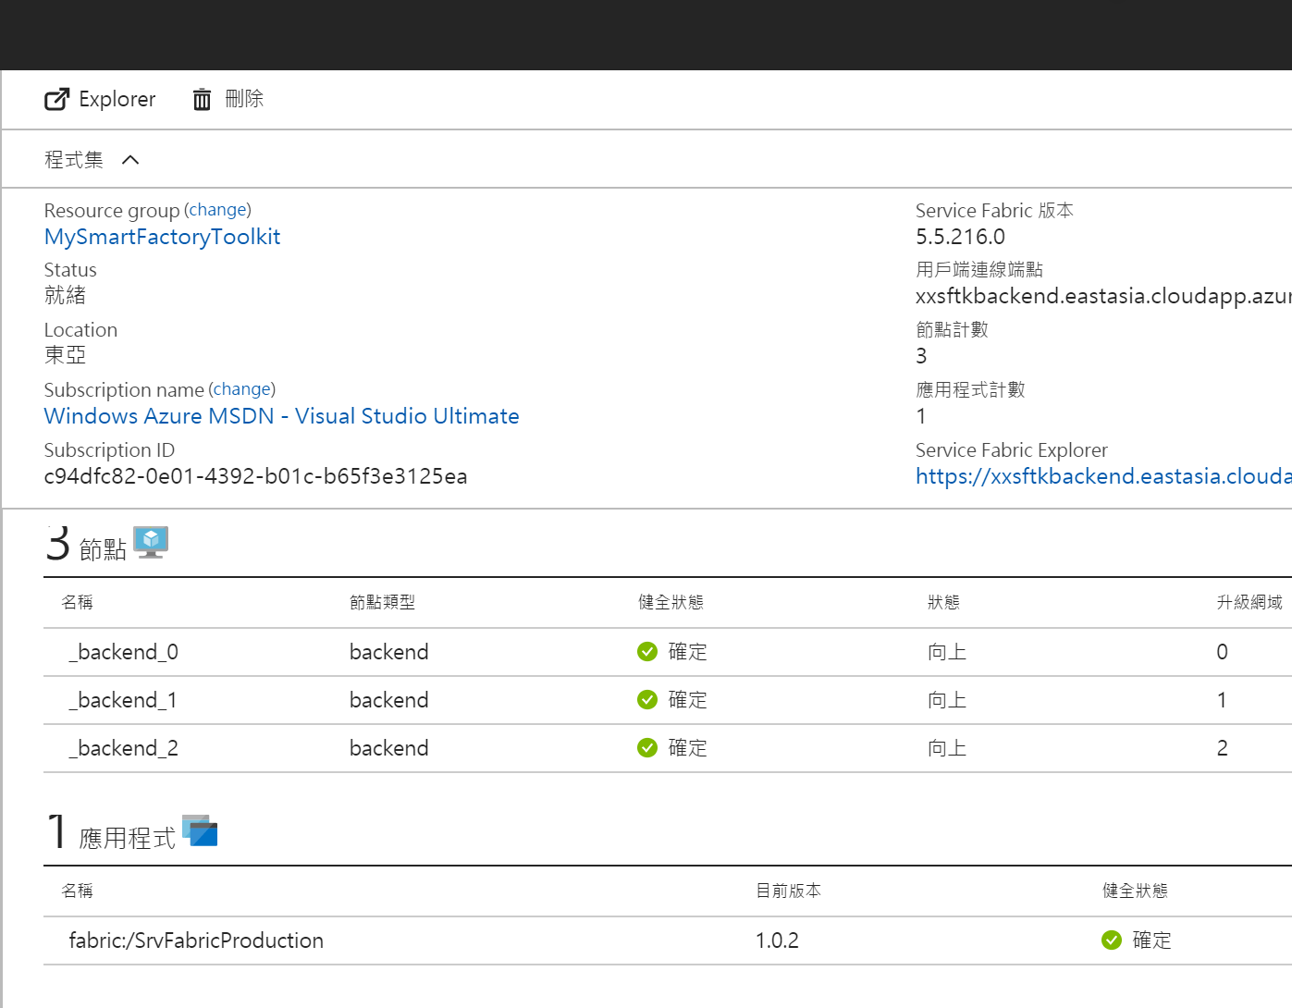
6. Verify Service Fabric on Azure Portal

Slide 36
One Thing Reminder

Slide 37
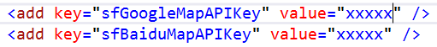
Google Map API Key
Admin web.config
Apply Google Map API Key (JavaScript)
https://developers.google.com/maps/documentation/javascript/get-api-key

Slide 38
Verify All Running Well

Slide 39
Provisioning a New Company
Super Admin
Create a new Company
verify the action appeared at backend tasks
verify collection be created on Cosmos DB
Create IoT Hub Alias for the Company
verify the action appeared at backend tasks
verify IoT Hub Receiver be launched
3. Create First Employee for the Company
Admin Web
verify First Employee able to login to Admin Web

Slide 40
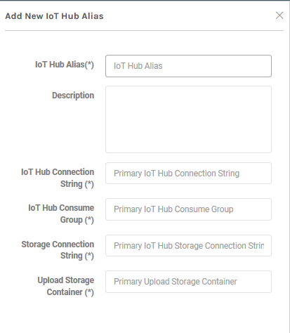
SuperAdmin: Company / IoT Hub / Add IoT Hub Alias
1
2
3
4

Slide 41
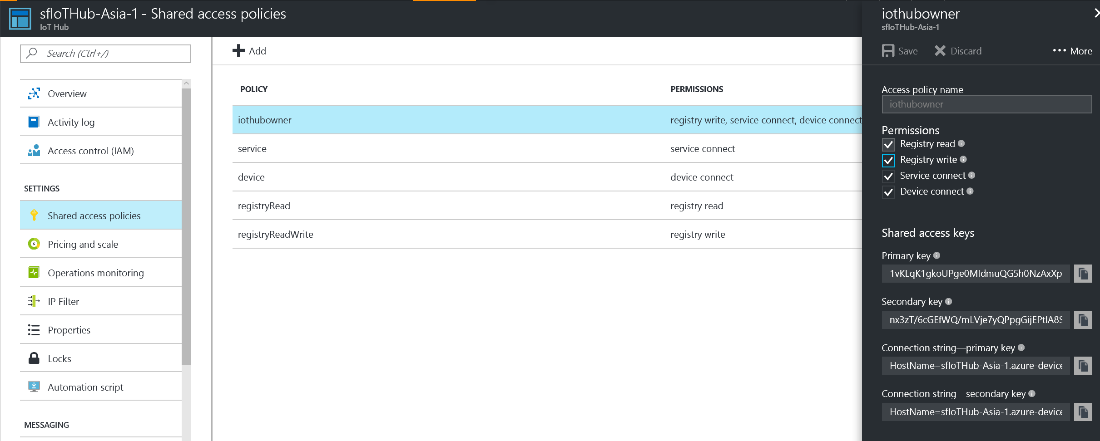
1
IoT Hub Connection String
B2
IoT Hub
* We need connection string, not key

Slide 42
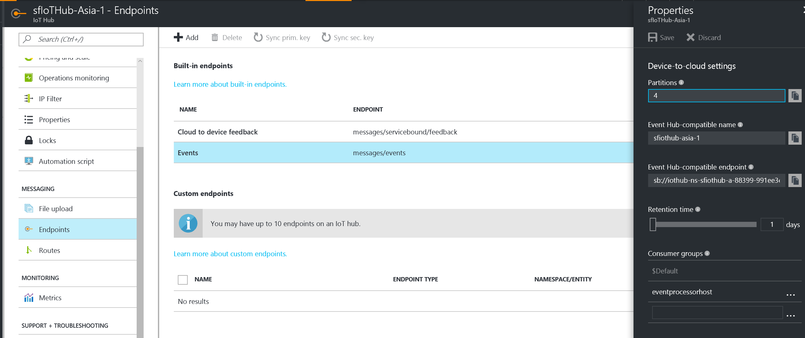
2
IoT Hub Consumer Group
B2
IoT Hub
* You have to create it, name could be “cdstudio”

Slide 43
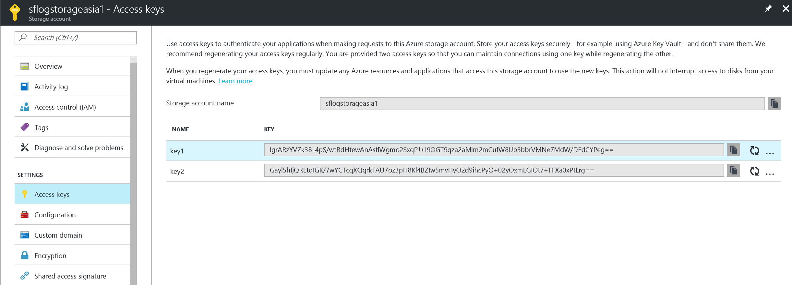
3
Storage Connection String
B2
IoT Hub
* We need connection string, not key

Slide 44
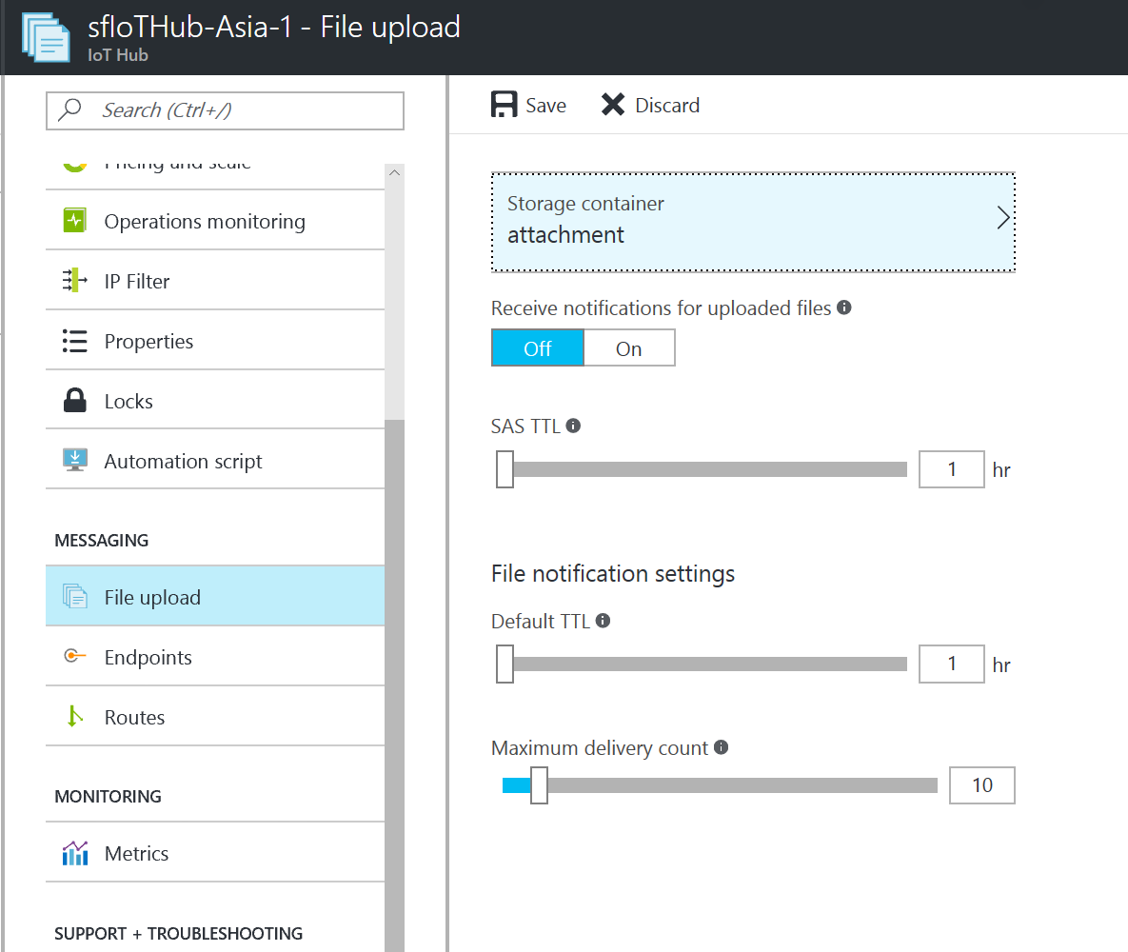
4
Upload Storage Container
B2
IoT Hub
Click IoT Hub you had at step 1.
You shall Pick Up CORRECT storage account, which you offered at step 3.
You shall create a container under this storage account which is going to store upload attached files. It is good to name it as ‘attachment’.

Slide 45
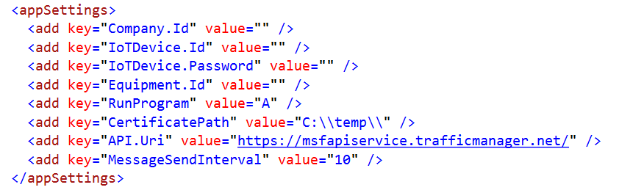
Pushing Telemetry from your Device
App.config of MachineEmulator
API.Uri shall point to your API Service

Slide 46
End
Kevin Kao | Walker Lin | Andy Li
Microsoft IoT Innovation Center

